Slide 1
AI-powered Adaptive Steganography
Department of Computer Science and Engineering
Project Review
Guided By
Dr. I. Kala
Associate Professor
Department of CSE
Submitted By
Carol S - 715520104005
Krishna Kumar - 715520104024
Nehya Ragavan V A - 715520104033
AI-powered Adaptive Steganography

Slide 2
Problem Statement
Traditional steganography techniques face significant challenges in effectively hiding large amounts of data within cover media while maintaining imperceptibility, withstanding attacks, and adapting to different media formats
The limitations of these techniques restrict their usefulness, especially when it comes to hiding large messages in images or adapting to various media types
This project aims to address these challenges by proposing an AI-powered steganography system with dynamic content protection, seeking to achieve a more robust, secure, and adaptable approach for secret communication
AI-powered Adaptive Steganography

Slide 3
Abstract Solution
The proposed system for embedding text into images utilizes a multi-step process leveraging deep learning models
Initially, a dataset of images is provided, and features are extracted from these images. These features are then fed into a Contrastive Model, a neural network, which creates embeddings representing the images. Subsequently, a Generative Adversarial Network (GAN), another neural network, is employed
The GAN takes the embeddings from the Contrastive Model as one input and a set of images as another input
The GAN is trained to generate stego images, where text is embedded within the images. The final step involves using the generator model, which is created through training the GAN network, to produce the stego image
In this process, the GAN network takes an input image and an input text embedding, generating an image where the text is embedded
This system enables the embedding of text into images, potentially enhancing communication security and data hiding capabilities
AI-powered Adaptive Steganography

Slide 4
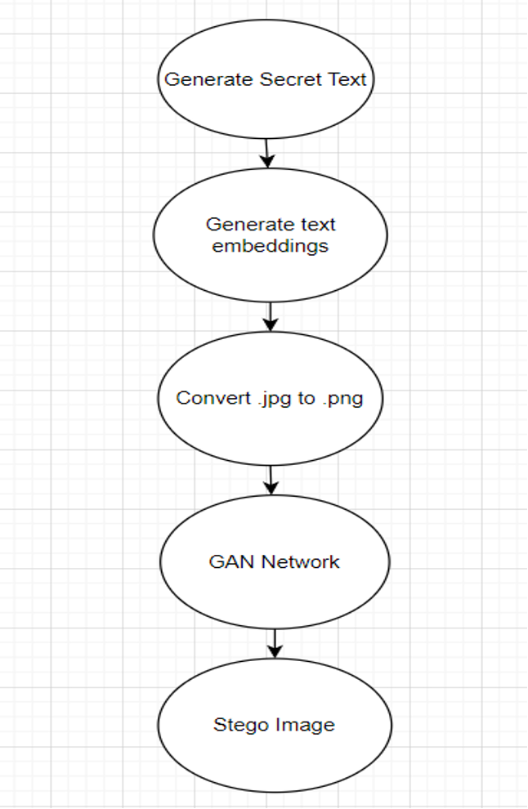
Block Diagram
AI-powered Adaptive Steganography

Slide 5
Proposed System
1. Generation of Embedding using w2vec model
2. Preprocessing of image: jpg to png
3. Encoding image using lsb steganography
4. GAN architecture
5. Decoder architecture (to decode words from the image)
6. Decode text from the predictions
AI-powered Adaptive Steganography

Slide 6
1. Generation of Embedding using w2vec model
Herethe process of generating word embeddings using a pre-trained Word2Vec model
Initially, the model is loaded, and its vocabulary is accessed. Following this, a list of random words is generated from the model's vocabulary
Subsequently, a function is defined to convert text into embeddings by tokenizing the text, obtaining word vectors, and averaging them to produce the text embedding. The code further demonstrates the generation of embeddings for the random words, which are then saved to a file
This showcases the utilization of a Word2Vec model to convert text into meaningful numerical representations (word embeddings), which are crucial for various natural language processing tasks
AI-powered Adaptive Steganography

Slide 7
2. Preprocessing of image (jpg to png)
It converts JPEG images to PNG format using the Python Imaging Library (PIL) in a Google Colab environment
It first mounts Google Drive to access the image files, then defines a function jpg_to_png to convert images
The function loops through files in the input folder, checks if they are JPEG images, opens them, saves them as PNG format in the output folder, and prints the conversion details
This preprocessing step can be used to standardize image formats for further analysis or processing in machine learning or computer vision projects
AI-powered Adaptive Steganography

Slide 8
3. Encoding image using lsb steganography
The process of encoding text into images using the Least Significant Bit (LSB) steganography technique
The code first mounts Google Drive and installs the necessary libraries. It then defines functions to preprocess images, encode text into images, and decode text from images
The encoding process involves converting the text into binary format and embedding it into the least significant bits of the image pixels
The code iterates through a directory of images, preprocesses each image, encodes a specific word into it, and saves the encoded image
This technique can be used for secret communication or watermarking images.
AI-powered Adaptive Steganography

Slide 9
4. GAN Architecture
This code implements a Generative Adversarial Network (GAN) using TensorFlow and Keras
The GAN comprises a generator and a discriminator trained concurrently. The generator generates synthetic images from input images and text embeddings, aiming to fool the discriminator, which distinguishes between real and fake images
The architecture includes convolutional layers, batch normalization, LeakyReLU activation, and dropout for regularization
The models are compiled with binary cross-entropy loss and the Adam optimizer with a learning rate schedule for stability
AI-powered Adaptive Steganography

Slide 10
5. Decoder Architecture
This code implements a decoder architecture to generate text from images using an LSTM-based sequence-to-sequence model
It begins by loading a pre-trained VGG16 model and adding additional layers for feature extraction
Then, it defines a decoder model with an LSTM layer to predict words based on the extracted features
The model is compiled with categorical cross-entropy loss and the Adam optimizer
Finally, it constructs an end-to-end model by chaining the encoder (VGG16) and decoder models, enabling the generation of text from input images

Slide 11
6. Decode text from the predictions
This code defines a function decode_predictions to convert model predictions, represented as sequences of probabilities, into text
It takes as input the predictions from a model and a tokenizer object used during training
The function first creates a reverse mapping from word indices to words using the tokenizer
Then, it iterates through each sequence of predictions, extracting the index with the highest probability at each time step and mapping it to the corresponding word
The decoded text strings are appended to a list and returned

Slide 12

Result
AI-powered Adaptive Steganography

Slide 13
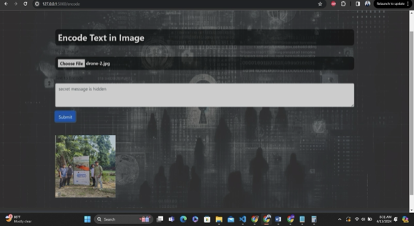
AI-powered Adaptive Steganography

Slide 14
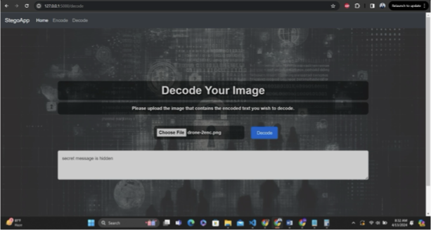
AI-powered Adaptive Steganography

Slide 15
Conclusion
In this project, we have successfully implemented a pipeline for embedding text into images using deep learning models. Starting with a dataset of images, we extracted features and used a contrastive model to create embeddings. These embeddings were then fed into a GAN network along with a set of images to generate stego images with embedded text. Through our experimentation, we have demonstrated the feasibility of using neural networks to embed text into images, opening up new possibilities for data hiding and information security.
AI-powered Adaptive Steganography

Slide 16
References
[1] N. Subramanian, I. Cheheb, O. Elharrouss, S. Al-Maadeed, and A. Bouridane, “End-toEnd Image Steganography Using Deep Convolutional Autoencoders,” IEEE Access, vol. 9, pp. 135585–135593, 2021, doi: 10.1109/ACCESS.2021.3113953.
[2] Y. Bhavani, P. Kamakshi, E. Kavya Sri, and Y. Sindhu Sai, “A Survey on Image Steganography Techniques Using Least Significant Bit,” Lecture Notes on Data Engineering and Communications Technologies, vol. 101, pp. 281–290, 2022, doi: 10.1007/978-981-16-7610-9_20/COVER.
[3] A. Menendez-Ortiz, C. Feregrino-Uribe, R. Hasimoto-Beltran, and J. J. GarciaHernandez, “A Survey on Reversible Watermarking for Multimedia Content: A Robustness Overview,” IEEE Access, vol. 7, pp. 132662–132681, 2019, doi: 10.1109/ACCESS.2019.2940972.
[4]J. Lu, W. Zhang, Z. Deng, S. Zhang, Y. Chang, and X. Liu, “Research on information steganography based on network data stream,” Neural Computing and Applications 2020 33:3, vol. 33, no. 3, pp. 851–866, Aug. 2020, doi: 10.1007/S00521-020-05260-4.
AI-powered Adaptive Steganography with Dynamic Content Protection

Slide 17
[5] M. Hussain, A. W. A. Wahab, Y. I. bin Idris, A. T. S. Ho, and K. H. Jung, “Image steganography in spatial domain: A survey,” Signal Processing: Image Communication, vol. 65, pp. 46–66, Jul. 2018, doi: 10.1016/J.IMAGE.2018.03.012.
[6] R. Hu and S. Xiang, “CNN prediction based reversible data hiding,” IEEE Signal Processing Letters, vol. 28, pp. 464–468, 2021, doi: 10.1109/LSP.2021.3059202.
[7] T. Luo, G. Jiang, M. Yu, C. Zhong, H. Xu, and Z. Pan, “Convolutional neural networksbased stereo image reversible data hiding method,” Journal of Visual Communication and Image Representation,
[8] C. Yuan, H. Wang, P. He, J. Luo, and B. Li, “GAN-based image steganography for enhancing security via adversarial attack and pixel-wise deep fusion,” Multimedia Tools and Applications 2022 81:5, vol. 81, no. 5, pp. 6681–6701, Jan. 2022, doi: 10.1007/S11042-021-11778-Z
AI-powered Adaptive Steganography with Dynamic Content Protection

Slide 18
Thank You ! Queries??
AI-powered Adaptive Steganography with Dynamic Content Protection

